Slide 1
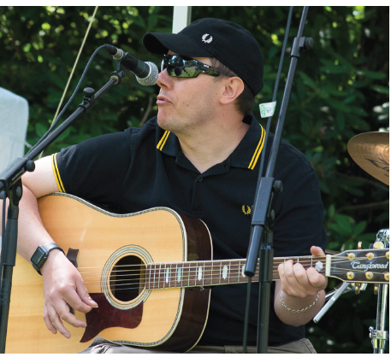
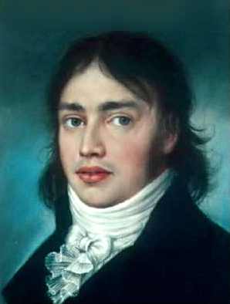
NEWSLETTER JUNE 2022
COMMITTEE CHANGES
At the first meeting following the AGM the various Officers are elected by the Committee members. This year the various officers are;
Chair, Martin Narraway: Vice Chair, Pippa Rothenberg; Treasurer, Ian Whitaker; Secretary, Ronnie Day
Widemar Spruijt was co-opted onto the Committee, bringing our number to 9 members. Widemar moved onto the Estate in 2018, is a professional town planner, member of the Conservation Area Advisory Committee and was runner-up in last year’s election.
HOLLY LODGE ESTATE SUMMER PARTY
We are looking forward to welcoming all residents to join us for our first Summer Party after a two years absence.
It will take place on the 26th of June from 12 noon to 5pm. All residents are welcome to enjoy music, kids games and entertainment. It will take place in Holly Lodge Gardens.
If you want to participate or you know someone who might, please contact Li via email:
li@weinreich.co.uk
CELEBRATE THE LIFE OF SAMUEL TAYLOR COLERIDGE: THE SAGE OF HIGHGATE
By Beth Shaw and Martin Bould
Come and take part in reading this hilarious panto version of Coleridge’s life (or just come to cheer and boo). It’s riotous but very scholarly (this is Highgate) and it’s FREE!
At the Holly Lodge Community Centre,
30 Makepeace Avenue
Tuesday 28th June
7.00-9.00pm
Wine, soft drinks and nibbles!
MAINTENANCE ON THE ESTATE
Work has started on the gates and will continue for the next 12 weeks, we hope this will not only make the Estate look good but hopefully also make the pedestrian gates easier to open and close, this will help security and prevent bikes from using the pedestrian gates.
PARKING PERMITS

Slide 2
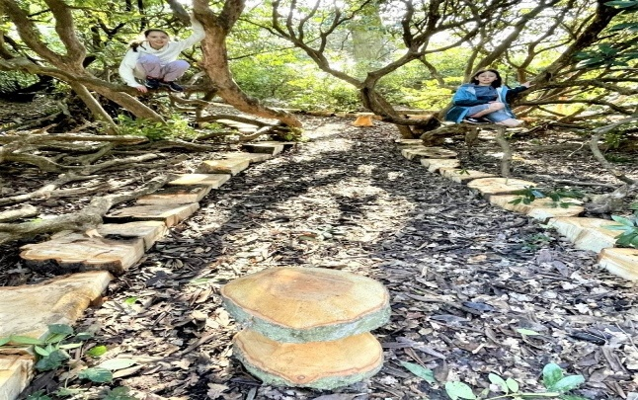
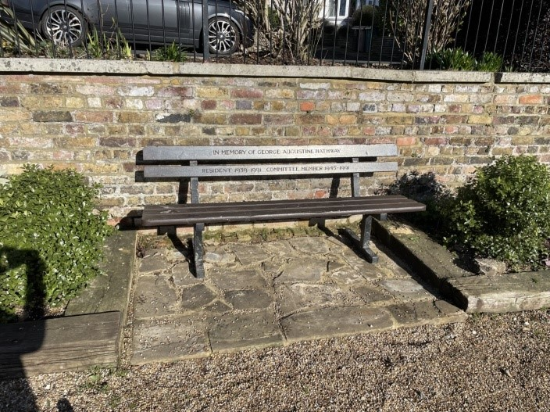
.
WORK ON THE ESTATE GARDENS
The HLE Maintenance team have been working hard in the HLE Ornamental and Lower Parks, with great results. They have been pruning and shaping shrubs, laying wooden edges on paths and York Stones paving in the seating area. We also now have a lovely clear view to the large oak tree at the bottom of Lower Park.
The team were also working on changing the course of the path that runs around the bottom, outer edge of the Lower Park, so that it now runs along the ground that remains dry even in the extremes of the winter. rains.
Previously this path had flooded in the heavy winter rain. This new pathway means that residents can walk around the outer margins of the park throughout the year. And of course, the children love playing in the trees in the newly opened up areas, as well as on the toadstools. All the wood used for the path edging and toadstools are from old HLE trees that have either blown down, or had to be taken down. Thank you team for the great work!
UP COMING EVENTS AND UPDATES
Heath Hands, the charity that carried out a workshop in the lower park, are running a Community Fun Day at the Parliament Hill Bandstand on the 12th of June, which residents are very welcome to come along to.
Forest School starts on the 9th and there are still some free spaces for residents. Please contact paula@urban-forest.org
Pink plaques are going to be placed on the gates of the estate to commemorate remarkable women, past and present who have lived in the Estate. These include Harriot Mellon, Baroness Burdett Coutts and Felicity Sparrow. For more details visit http://www.pinkplaques.org/
The annual Highgate Festival begins on the 11th and finishes on the 19th . There are many events, such as exhibitions, walks and talks happening all over the area celebrating the culture and life of Highgate. For more information go to Events | For Highgate
HOLLY LODGE ESTATE COMMEMORATIVE BENCH
Holly Lodge Estate is a living, thriving community, and whilst on occasions it may be appropriate to have a commemorative bench, where ever possible, the benches are provided to ease tired limbs, facilitate conversations with neighbours and friends and for people to be able to peacefully enjoy the HLE Estate and gardens. Our Eligibility Criteria for the benches will be added to the up to date website which will be launched shortly.
Feel free to call the HLE office if you have any further questions.
Be sure to use the SUGGESTION BOX email for your comments: suggestionbox@hle.org.uk
HLE FOREMAN – Gerry Hartigan:
Mobile phone: 07447 869570 Email: foreman@hle.org.uk
HLE MANAGER – : Antonia Pereira
Office: 0203 538 4454 Mobile phone: 07731 301119 Email: manager@hle.org.uk
HLE COMMITTEE SECRETARY – Ronnie Day:
Email: secretary@hle.org.uk

