Slide 1
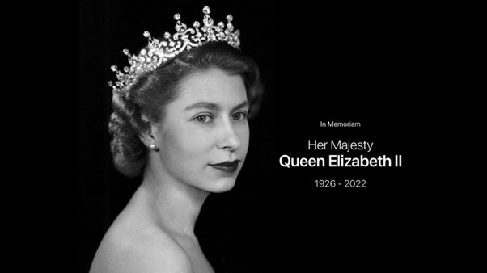
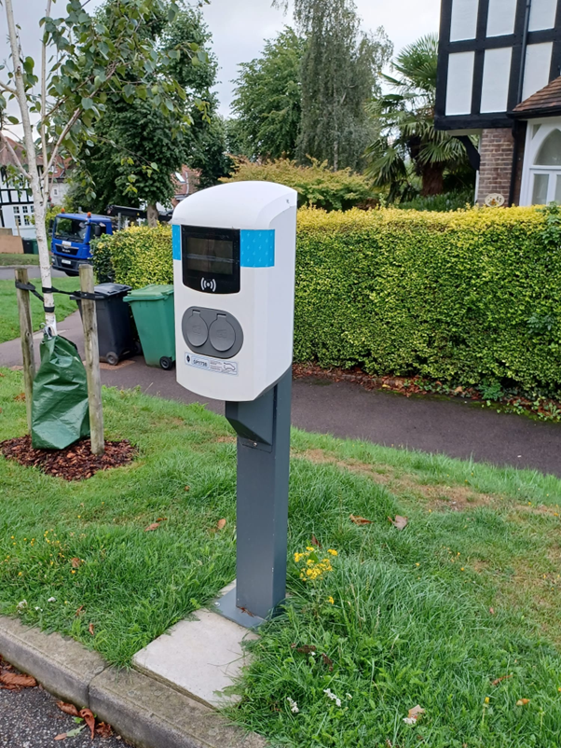
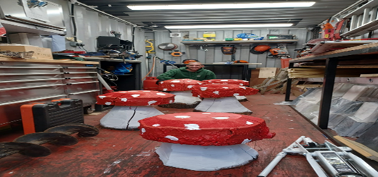
NEWSLETTER SEPTEMBER 2022
HLE Committee and The Gardening Team wanted to pay tribute to her majesty Queen Elizabeth II and a life dedicated to the service of her country. Our deepest sympathy to our Royal family and the King
PLOT-OWNERS’ HALF YEARLY GENERAL MEETING
The 2022 Half Yearly General Meeting for Plot Owners is scheduled to be held on Wednesday 9th November at 8pm at the Community Centre.
Please send any motions to be considered at the GM to committee@hle.org.uk 12thOctober latest
ELECTRIC CAR USERS
I want to remind all residents that we have three charging points on the Estate. If you have an Electric car, do please get in touch with me for further information, it might make charging your car much easier.
We Use Genie, they have charging points throughout the country.
Please email me or come to the hut and I will help you to register your vehicle.
NEW ADDTIOINS TO LOWER PARK
Look out for our new Toad Stools, they will be appearing dotted around lower park soon. They will make a bright fun addition to our beautiful gardens.
WELL DONE DEAN!!
He can be seen looking like an elf in the background
It was totally his idea and creation!

Slide 2
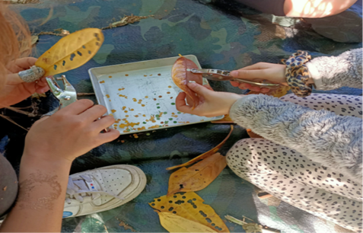
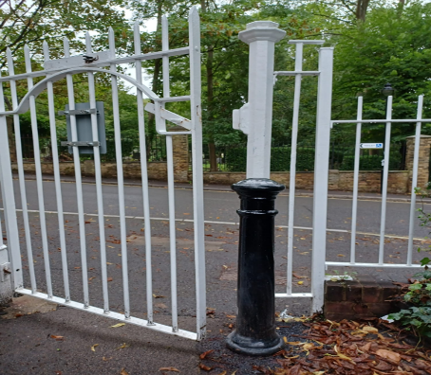
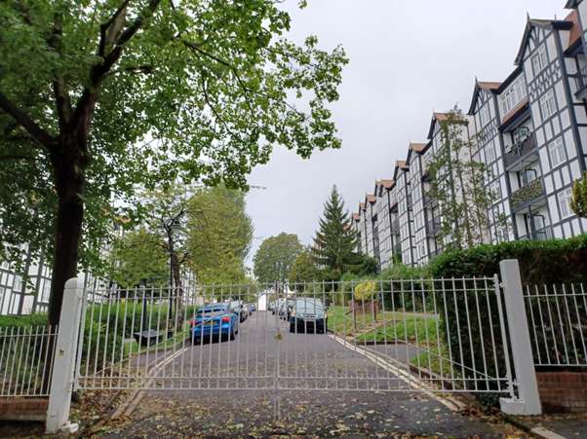
.
Urban Forest After School Club
Following a great start in the summer term we are back for the first 7 weeks of the autumn term. Our sessions are inspired by the forest school practice and ethos, they are designed to promote environmental awareness, stimulate imagination, and encourage sustainability, creativity and Investigation through activities such as den building and natural art.
Location Holly Lodge Gardens
Dates: Every Thursday from 8th Sep – 20th October
Adhoc & block booking options
Times: 3.45 pm – 5.45 pm
Price: £15 per child per session
Ages: 5-11 year olds
Contact Paula Harvey at paula@urban-forest.org or visit www.urban-forest.org to find out more
GATES
All our gates have finally been finished, the contractors have painted all of them, aligned some of them so they close property, replaced rotten wooden posts and added a bike gate to Holly Lodge Mansions.
We have also added two bollards to the north pedestrian gates at Holly Lodge Mansions and Makepeace Mansions, this is to prevent the bin men from damaging the gates, walls and posts. Attempts were made to prevent this damage prior to installing the bollards with little success, but after spending a large sum of money on the gates, we wanted to prevent future damage! We have taken note of comments on the WhatsApp Group and taken the closers off for now, we will replace them with closers that are easier to open.
COMMUNITY CENTRE
COUNCILLORS QUESTION TIME
Wednesday September 14th at 7pm
Our three local councillors are coming to the Community centre on Makepeace Avenue to answer your questions. Come along and ask a question or just to listen in & meet your neighbours afterwards over refreshments. If you have a question you’d like to ask, it would be helpful if you could mail it to us in advance at hollylodgera@gmail.com or you’re welcome to just put your hand up & ask on the evening.
Community Centre opens from 6..30pm
Question Time starts at 7 pm
Followed by Refreshments
Be sure to use the SUGGESTION BOX email for your comments: suggestionbox@hle.org.uk
HLE FOREMAN – Gerry Hartigan:
Mobile phone: 07447 869570 Email: foreman@hle.org.uk
HLE MANAGER – : Antonia Pereira
Office: 0203 538 4454 Mobile phone: 07731 301119 Email: manager@hle.org.uk
HLE COMMITTEE SECRETARY – Ronnie Day:
Email: secretary@hle.org.uk

