Slide 1
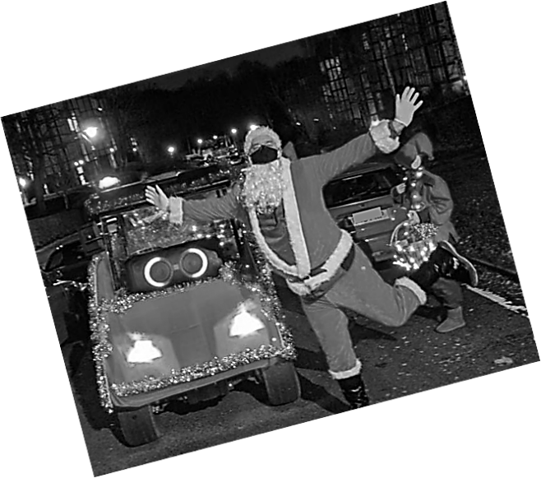
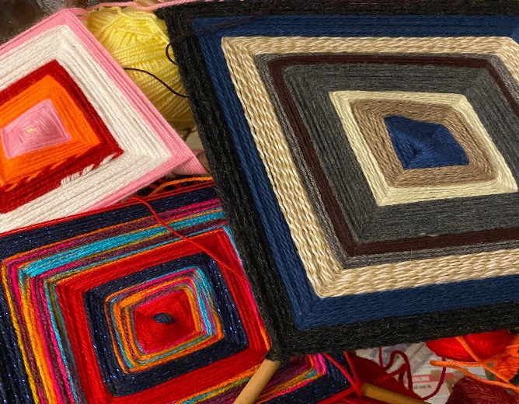
NEWSLETTER DECEMBER 2022
FATHER CHRISTMAS IS BACK AGAIN ON SATURDAY DECEMBER 17th
Santa and his elves are back bringing gifts to our Estate children on his festive sleigh. If you would like him to deliver a present on Saturday 17th December them please contact Grace at Grace_Livingstone@hotmail.com giving the names and ages of your children plus your address, of course!
There will be mulled wine, mince pies and carols outside the Community Centre on Makepeace Avenue at 6pm after he and his helpers have finished their rounds. Please do come and join them and share some festive cheer with your neighbours.
If you want to spread more cheer and joy for the kids in the
Estate ,then please donate to this event. You can donate to the account below.
Account name: Holly Lodge Residents Association
Account 25 30 61 88
Sort code 09-01-55
Ref: Santa
POLLARDING
Pollarding of the Lime trees on and adjacent to Hillway has been completed. The Pollarding cycle will begin again in two years, when those pollarded last year will be redone.
CHRISTMAS LIGHTS
We have been very busy decorating the Estate getting it ready for the Christmas season, we have decorated the roundabout at the top of the Hillway and the pillars at the bottom of Hillway. This year we have also extended our efforts to the Ginko tree! We do hope you like it.
WARM PLACE
Community Centre
Every Thursday, from 10.30 to 3pm
All materials provided, you are also welcome to bring your own creative projects along.
Light refreshments
Tea, coffee
No need to book!!
Free and fun for KIDS and ADULTS!

Slide 2
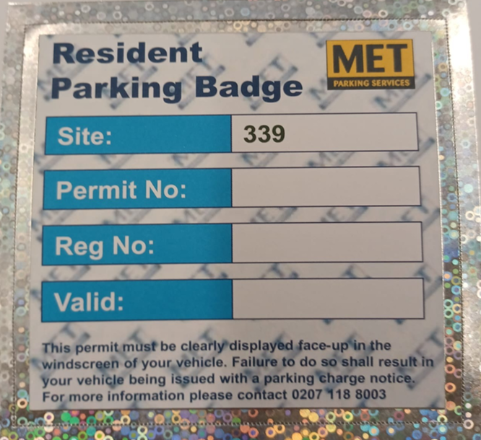
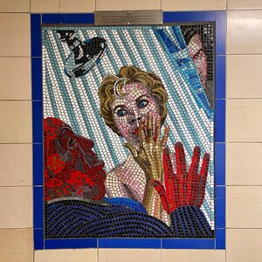
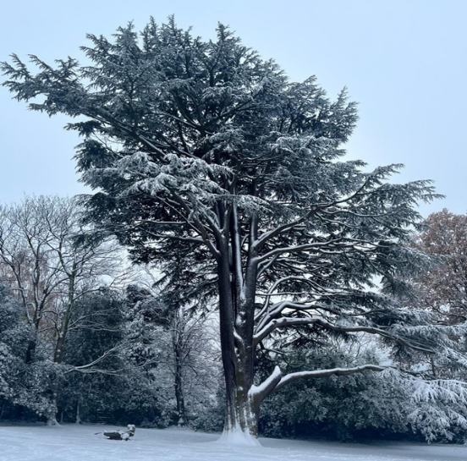
PARKING PERMITS FOR 2023
Please do not forget to look out for you email asking you to renew your Holly Lodge Parking Permit. If you do not get any emails please let me know. If you get the email and you respond but you do not get your permit please also get in touch. You can call me, email me or pop in to see me, my details are on the bottom of this newsletter.
London School of Mosaic is a local independent training centre for mosaic art,
based in the under croft of Ludham estate on Mansfield Road and alongside Lismore Circus. We offer short courses in mosaic, volunteering opportunities as well as house 2 other arts charities who teach art and design to children. We have a community canteen called Mother at the Mosaic, where the public is welcome to enjoy home cooked meals and a variety of hot and cold drinks, as well as food events on Saturdays. Over the next 6 months we will be expanding our offer to provide more spaces for artists, charities and community groups, as part of the Mayor’s Good Growth fund which will bring back into use empty garages in the under croft where we are based.
You can find out more about us:
www.lsomosaic.com / info@lsomosaic.com
https://www.instagram.com/mothercanteen/
WINTER SNOW
We have had an unexpected large amount of snow recently and the team have worked hard to make sure all roads, paths steps, entrances and exits are gritted and hopefully safe for all residents. We will continue to keep an eye on further weather forecast and to stay on top things But doesn’t it look beautiful!
Be sure to use the SUGGESTION BOX email for your comments: suggestionbox@hle.org.uk
HLE MANAGER – Antonia Pereira:
Office: 0203 538 4454 Mobile phone: 07731 301119 Email: manager@hle.org.uk
HLE FOREMAN – Gerry Hartigan:
Mobile phone: 07447 869570 Email: foreman@hle.org.uk
HLE COMMITTEE SECRETARY – Ronnie Day:
Email: secretary@hle.org.uk

