Slide 1
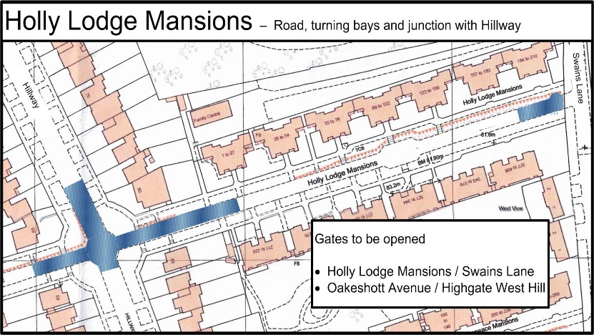
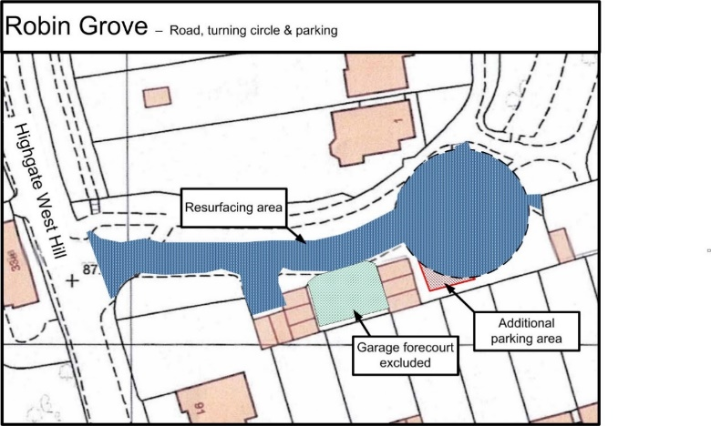
NEWSLETTER FEBRUARY 2023
ROAD RESURFACING WORKS
Commencing Monday 6th March road works are due to start in 3 locations and last 5 days;
Robin Grove. All of Robin Grove excluding the concrete forecourt between the 6 garages but including the access to the 2 garages near the entrance. Additionally, the circle at the end will be enlarged to provide some additional parking spaces.
Hillway / Oakeshott Avenue crossroads. This extends north to 67 / 62 Hillway and east to the first blocks of flats.
Holly Lodge Mansions / Swains Lane junction.
On the Monday work will be restricted to Robin Grove but thereafter will extend to all areas. Whilst equipment is being used vehicles will be barred from the work area but thereafter, they can enter with care (i.e. after an area has been planned ready for tarmac)
Notices will be put up restricting parking. The gates at the end of Oakeshott Avenue/Holly Lodge Mansions will be opened.
More details available from the Estate Manager
ANNUAL GENERAL MEETING OF PLOT OWNERS ON THE HOLLY LODGE ESTATE
The Annual General Meeting of Estate plot owners is to be held on the evening of Wednesday 26th April 2023 at the Holly Lodge Community Centre, 30 Makepeace Avenue. Further details, agenda etc. to follow.
As usual three Committee places are up for election this year. Should any plot-owner wish to stand for election to the HLE Committee please request an application form from manager@hle.org.uk and return it with a passport style photograph by post, email or in person no later than 29-Mar. Also, should you wish for a motion to be considered by the Committee for discussion at the AGM please submit this by post, email or in person also before 29-Mar.
PARKING PERMITS
We are beginning to issue the 2023 parking permits You will receive an email with a link to verify your need for a new permit. Please look out for this email - check your junk mail, and follow the simple instructions. If you have changed your email address since you originally applied for your permit then please do update us as soon as possible otherwise you will miss the renewal link.
If you have a new car then you will need to complete an application form, which can be found on our website www.hle.org.uk under Residents/Car Permit.
The 2022 permits are still valid for the time being and we will let you know in good time when they are due to expire.

Slide 2
LOG BURNING STOVES
There has been a lot in the press recently about the harmful pollution caused by log burning stoves. Most people think that There has been a lot in the press recently about the harmful pollution caused by log burning stoves. Most people think that wood smoke is harmless, whereas it is in fact it is “as harmful as the pollution from traffic or industry” Garry Fuller, The school of public health, Imperial College. The pollution from burning wood is fine particle matter, PM2.5 which has been linked to diverse health problems, affecting heart, lungs, and the brain. The Committee on Climate Change, the statutory adviser on greenhouse gas emissions has called for domestic wood burning stoves to be phased out. Perhaps think twice before lighting your stove, particularly on still nights. The new eco-design wood burners reduce the air pollution and provide more heat, so replacing your old wood burner might be a good option.
NEWS FROM THE TEAM
PLANTING TREES, RAILING AND WILDING AREA
We have been busy over the last two months planting trees, rotavating the wilding area and preparing beds for the spring time.
We are painting all the railings in the Top park, getting them looking good before the plants in the beds start growing.
We have received our wild flower seeds and will be starting to plant them in all the wilding areas in March.
Look out for all the bulbs which will start appearing in the coming weeks.
Welcome to OPEN HOUSE activities every Thursday at Holly Lodge Community Centre 10am-3pm.
Please pop in for a chat, a cuppa and some light refreshments whilst meeting friends from your local community. You could also try your hand at table tennis, crafts or sit quietly and read your book if you wish. Maybe you prefer to bring your laptop and do some work in our warm and welcoming space?
Drop in and free of charge. See you there😃.
Tai Chi Mondays/Fridays info@taichi4tennis.com
Seasons art classes (50+) Wednesdays tel: 020 8444 8205
Pilates Tuesday, Thursday, Friday, www.harmonypilateshighgate.co.uk
Messy Hands (0-36 months) alternating Tuesdays messyhandslondon.square.site
Mini Mindful Musicians Friday (0months-5years) minimindfulmusicians.co.uk
The Adamo Duo is booked to perform a programme of music for the cello to take place at the HLCC centre on the 12th March at 3 pm.
Entrance fee £5.00 which is bookable in advance from HLCC or payable on the door
Be sure to use the SUGGESTION BOX email for your comments: suggestionbox@hle.org.uk
HLE MANAGER – Antonia Pereira:
Office: 0203 538 4454 Mobile phone: 07731 301119 Email: manager@hle.org.uk
HLE FOREMAN – Gerry Hartigan:
Mobile phone: 07447 869570 Email: foreman@hle.org.uk
HLE COMMITTEE SECRETARY – Ronnie Day:
Email: secretary@hle.org.uk

