Slide 1
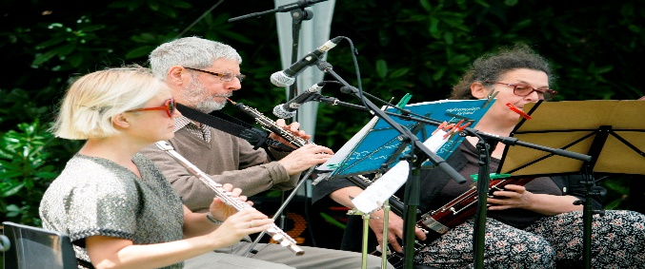
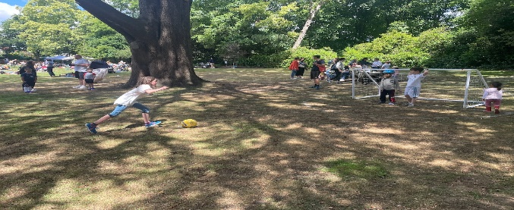
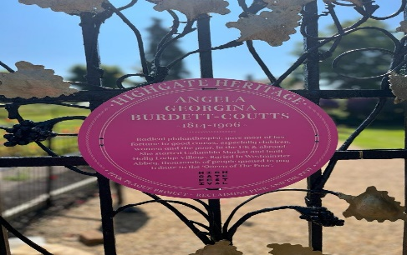
NEWSLETTER JUNE 2023
SUMMER PARTY
On the 25th of June
12 noon to 5 pm
Please put the date in your diary
We will need volunteers to help with the children's games and the face painting, anyone who is interested please email me or pop in to see me.
We are looking for musicians, singers and performers to join us. All performers welcome. We are particularly keen to get some new talent involved and any type of music, is welcome.
POLICE SURGERY
17TH OF JUNE
3 PM AT THE COMMUNITY CENTRE
Three member of the Met Police Services will be attending the community centre to provide guidance and information to all residents who want to attend. This information will provide information to all of you on how to secure your houses, cars and property from crime. All residents are welcome to attend. There will be a small talk followed by a questions and answer section.
FOXES AND DOG DROPPING
We continue to have issues with dog owners not clearing up after their dogs, we have started using pink chalk spray to highlight the issue and hopefully encourage people to clear up their dog mess. I am asking all dog owners to be responsible and consider other residents.
Please have a look at the links below. They are wild animals who should be scared off us, so please refrain from feeding them to prevent them losing their fear and coming into homes.
https://www.bbcwildlife.org.uk/urban-fox
Fox proof food bin
PINK PLAQUE PROJECT
This campaign highlights the most remarkable women in our area, we are lucky enough to have 4 of these on site. Harriot Mellon, actress and beauty who married Thomas Coutts. Baroness Angela Burdett Coutts who was a pioneer and philanthropist. Felicity Sparrow, a film maker and feminist and finally Stella Gibbons who was an author and a poet. https://highgatefestival.org/pink-plaques/

Slide 2
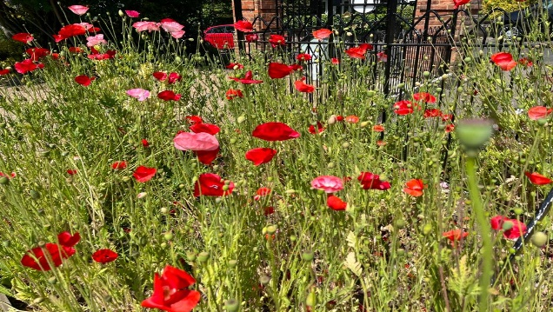
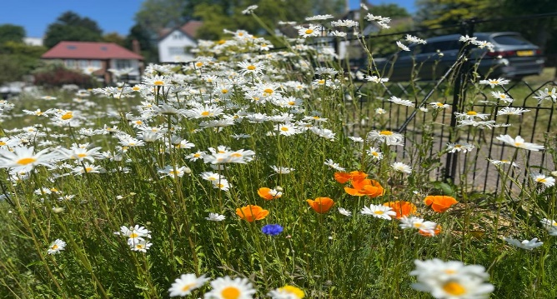
BIKES
Later this month Camden will be installing 3 cycle hangars, one each in Holly Lodge, Makepeace & Langbourne Mansions. The hangars will be managed by Cycle Hoop, those interested in renting a space should check https://www.cyclehoop.rentals/ to apply.
The TRA is also working on improving the storage around the flats but need the abandoned bicycles be identified. Look out for WhatsApp messages / Section 41 notices.
We also ask users of dockless bikes (Lime, Human Forest, etc) to leave them off the estate in designated bays and not on the HLE.
NEWS FROM THE TEAM
ORNAMENTAL GARDEN
Our wilding area is really coming along, and we hope the other wilding areas will catch up soon.
We have extended the Pergola and we will be planting roses and climbers soon. It will take many years to cover but it is a great addition.
The bath bed is really looking summery and bright. Barbara Coutts would be proud!
PLEASE HELP US BY WATERING THE TREES OUTSIDE YOUR HOUSE IN THIS HOT WEATHER!!
IF YOU HAVE ANY ISSUES WITH OUR WORK, PLEASE CONTACT THE HLE MANAGER DIRECTLY
Highgate-The story of a London Highgate-The story of a London village over 800 years
A documentary film revealing the story of Highgate from its medieval origins to the 20th century will be shown on Saturday 17th June at 6pm. Doors will open at 5pm. Refreshments available for a donation to the Holly Lodge Community Centre. This event is a part of the Highgate Festival.
Sunday 9th July 10am-4pm The Holly Lodge Community Centre Summer Fair with face painting for children, cakes, ice cream, Jumble sales and a lot of fun! Come and support your local community centre. We're looking for people that would like to book a table and sell their pre-loved items i e bric-a-brac, toys, books etc but NO CLOTHES PLEASE! Each table costs £15. The centre also welcomes donations of pre-loved items that can be sold by the centre. NO CLOTHES PLEASE! Donations and the profit will go to the centre. There'll be a lovely cafe set up at the terrace and if you love baking, you're very welcome to bring us lots of delicious cakes that we can sell on the day. Opening times at HLCC for donations: Mondays, Tuesdays and Thursdays 10am-4pm Cake donations: Saturday 8th July 12-4pm.
Please email hollylodge.manager@gmail.com if you would like to book a table (first come first served) Thank you very much for your support and we're looking forward to seeing you at the HLCC summer fair!
Be sure to use the SUGGESTION BOX email for your comments: suggestionbox@hle.org.uk
HLE MANAGER – Antonia Pereira:
Office: 0203 538 4454 Mobile phone: 07731 301119 Email: manager@hle.org.uk
HLE FOREMAN – Gerry Hartigan:
Mobile phone: 07447 869570 Email: foreman@hle.org.uk

