Slide 1
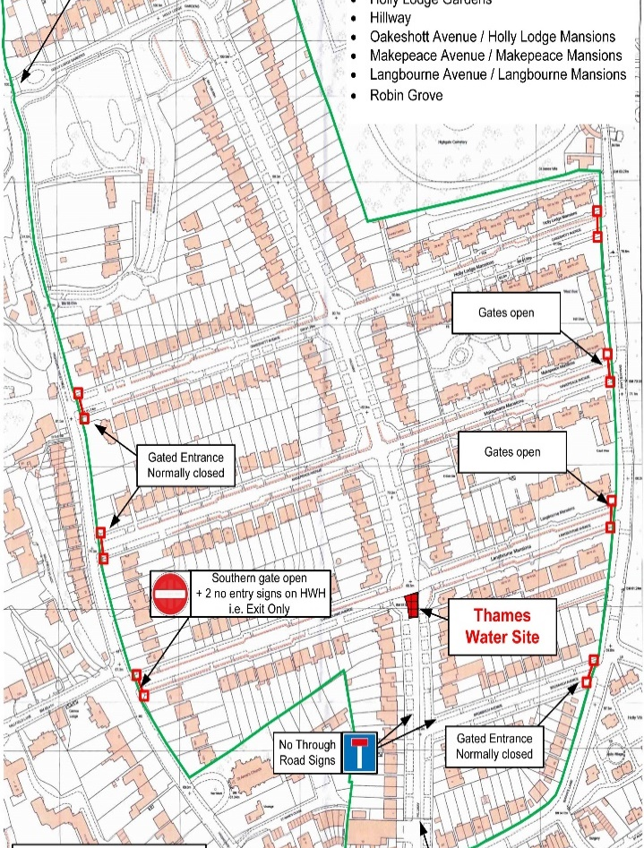
NEWSLETTER AUGUST 2023
HOLLY LODGE ESTATE SUMMER PARTY
Our yearly Summer Party took place on the 25th of June. Luckily there was no rain and fun was had by all, kids included! I would like to thank our regular performers, John and Roger as well as the new performers. William, Sean and Nicola were there to help set up and clear up and I wanted to thank them too. I really hope everyone enjoyed their day; we are very much looking forward to next year which will be our centenary! Really hope you can all come.
Please start thinking of anyone
on the Estate who might want to
PERFORM NEXT YEAR !!!
ROADWORKS ON HILLWAY
THAMES WATER
To reinforce the water supply on the Estate a new water pipe connecting the existing mains running up either side of Hillway is being installed. The works are scheduled to start 21-Aug-23 and last up to 2 weeks (4-Sep). Whilst Hillway is closed diversions will be in place, notably;
Bromwich Avenue / Swains Lane – gates to be open
Langbourne Avenue / Highgate West Hill – exit gate to be open
Langbourne Avenue / Swains Lane – gates open
Makepeace Avenue / Swains Lane – gates open
Holly Lodge Gardens / Highgate West Hill – barriers to be raised at all times.
Thames Water will be erecting various diversion signs to assist drivers.
PLEASE WATER THE TREES OUTSIDE YOUR HOUSE
It has not been as hot as last summer and there has been some rain, however, if you have a tree outside your house, please water it every now and then. It helps us to keep them fit and strong. We have only lost one tree this year and we do not want to lose any others.
HISTORY OF THE ESTATE
We are planning a small movie about the Estate to celebrate our Centenary. Please get in touch with Annee Marrie (our movie maker) by email if you would like to talk to her about your memories and experience of Holly Lodge Estate. She is especially interested in hearing from long-term residents. anneemarie@gmail.com

Slide 2
.
WILDING AREAS ALL OVER THE ESTATE
There has been many lovely photos of our wilding areas on the Community Support WhatsApp Group. Thank you all for your positive feedback. We are glad you like them. Some of your photos below.
We have been working very hard to make a success of them this year. A special thanks to Dean and Rosie who were the project leaders on this.
May I ask people to not walk on them but to keep to the pavement.
Fundraising for Breast Cancer, on Saturday the 19th of August from 3pm to 5pm at the Holly Lodge Community Centre. Come along and enjoy cakes, biscuits, tea, and coffee and win some amazing prizes in our raffle. Free entry. Donations for this worthy cause will be much appreciated.
DRAMA WORKSHOPS !
For 8-12 year olds.
Led by two professional actresses/workshop leaders.
Monday 31 July and Tuesday 1 August, 10am to 4pm, in the Holly Lodge Community Centre.
£40 for the day; £30 concessions.
Will be working on devising a story for performance. Will include lots of games.
Please contact Lisa Rose at lisajrose@hotmail.com
Be sure to use the SUGGESTION BOX email for your comments: suggestionbox@hle.org.uk
HLE FOREMAN – Gerry Hartigan:
Mobile phone: 07447 869570 Email: foreman@hle.org.uk
HLE MANAGER – : Antonia Pereira
Office: 0203 538 4454 Mobile phone: 07731 301119 Email: manager@hle.org.uk
HLE COMMITTEE SECRETARY –
Email: secretary@hle.org.uk

