Slide 1
NEWSLETTER SEPTEMBER 2023
HLE EV CHARGERS PRICE CHANGE
From the 1st of October the price of the electricity supplied from the 3 chargers on Makepeace Avenue will change from current 29p/kWh to 54p/kWh to reflect the increase in electricity following the expiry of our original contract. The price is competitive with other suppliers. Elsewhere Genie Point, who manager our system charge 75p – 79p depending on the time of day. BP Pulse is similar.
Other charges, the £1 connection & £10 overstay (>14hrs connection) charge, remains unchanged.
ROADWORKS ON HILLWAY
THAMES WATER
Thankfully, Thames Water have finished their work. I wanted to thank you all for your patience during the works and the closure of Hillway. Our team will be making good the grass verges in that area.
AVENUE GATES
The gates at the end of the Avenues which are normally closed are being opened and left open, It is not clear who is doing this but it you find a gate open, please notify the Estate Manger
URBAN HILL CLIMB
This annual cycling event will take place on Saturday 30 September. We have been working with the organisers to make sure that any disturbance to our Estate is minimised.
BATS IN THE HOLLY LODGE ESTATE AREA
I went on a really enjoyable Bat Walk, last week on the Heath, led by Heath Hands.
As some of you may know, the HLE team, including myself, recently made bat boxes to fix on the trees in the HLE Lower Gardens. The boxes were designed to offer homes to two sizes of bats and are still awaiting occupants. However last week at dusk, I was delighted to see a bat in my own Langbourne Ave garden, flirting backwards and forwards in the half light.
On the Bat Walk, we were told that there are amazingly 12 different species of bat living on the Heath, out of a total of 18 species that live in the UK. We used handheld ultrasonic microphones to detect the echo location of the bats, which were swooping low over our heads, catching insects close to the boating pond and under the trees just below Kiting Hill. We were very excited to successful identify three species of bats. Let’s hope that before too long some of the Heath bats find our bat boxes on the trees in the Lower Gardens.
Rosie Durant.

Slide 2
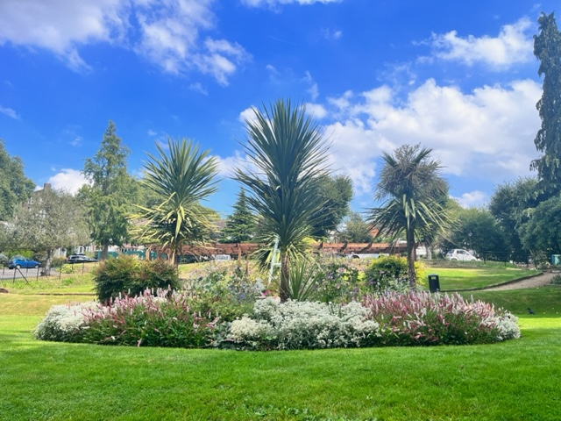
.
ORNAMENTAL GARDEN
I want to thank all the lads and Rosie for all the hard work they have done on the ornamental garden this year, the extended pergola, the ornamental bed and the newly painted and gilded gates have really made the whole garden look amazing. We will be planting climbers on pergola; it will take time for them to grow but that is the nature of gardens.
Every year we buy a quantity of bulbs to populate areas if the estate that are still not done, and we will be planting them in the coming month, look out for new blooms in the spring!!
Films and Poetry:
Monday poetry at 2 pm: Every Monday alternating with the films
Events:
Sun 15th Oct at 3pm: Music recital. Fabio Fernandes, professional musician, playing classical guitar and lute. Tickets including programme £6.
Sat 28th Oct at 2-6pm: Play table tennis. Compete or just have fun. All ages and abilities welcome.
Sat 18th Nov at 10am-6pm: Christmas Fair, curated by jewellery/handbag designer Nadia Minkoff. Local makers/brands selling their craft.
Sunday 26th Nov at 3pm: Music recital. Susie Wanshu, student at the Royal Academy of Music, performing a viola concert. Tickets including programme £6.
Be sure to use the SUGGESTION BOX email for your comments: suggestionbox@hle.org.uk
HLE MANAGER – : Antonia Pereira
Office: 0203 538 4454 Mobile phone: 07731 301119 Email: manager@hle.org.uk
HLE FOREMAN – Gerry Hartigan:
Mobile phone: 07447 869570 Email: foreman@hle.org.uk
HLE COMMITTEE SECRETARY
Email: secretary@hle.org.uk

